Slide 1

CAR PRICE
PREDICTION
PROJECT
Submitted By :
Kundan Patil

Slide 2
Introduction
With the covid 19 impact in the market, we have seen lot of changes in the car market.
Now some cars are in demand hence making them costly and some are not in demand hence cheaper. One of our clients works with small traders, who sell used cars. With the change in market due to covid 19 impact,
our client is facing problems with their previous car price valuation machine learning models. So, they are looking for new machine learning models from new data. We have to make car price valuation model through new data which is going to predict the price of used cars.

Slide 3
Conceptual Background of the domain problem
First of all we should be knowing how to scrap the required data from various websites through the techniques of webscrapping, In order to do that we should extract all the urls of each car using relevant xpaths , we should be knowing how to build a linear regression model through collected data.
Literature Review
To get the enough amount of relevant data we have to crawl through Google to get perfect website, In that process we ended up landing in car trade.com,droom India and Quickr.
We have listed out 8 such websites from which we can get the adequate information, They are as follows Quickr,Indian Outdoor.com, Ola India, Car dhekho, Olx, Cars24, Droom India, Carwale, Car Trade India.

Slide 4
Mathematical and Analytical understanding of the problem
The data we collected was in in terms of rows and columns, there are 8 columns and 5993 rows out of which 3 columns where of integer type and remaining are object type, so in order to make the machine understands this we have to convert the categorical value to numerical values we accomplish it through label encoding or one hot encoding.
We did scaling of the dataset in order to have values of variables within certain limits so that machine can perform better, for this purpose we used different types of scaling namely standard scaling, min max scaling and Robust scaler, later we reduce the skewness using various techniques.
Hardware and tools used
Hardware : We used the hardware of 8GB RAM,1Tb ROM and i5 processor.
Software : For better visualization we used Tableau Public, Jupyter notebook from anaconda navigator for coding and webscrapping and Microsoft word and Power Point Presentation for creating the report and making the presentation respectively.

Slide 5
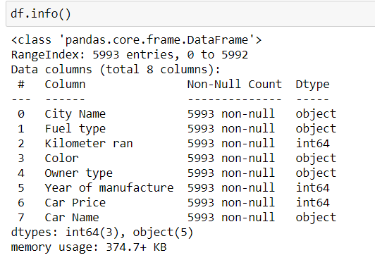
Data Source and their format
The major portion of the data we collected from car trade.com , there are 8 major parameters and 5993 rows out which 3 are of integers type column and remaining's are of categorical type columns.

Slide 6
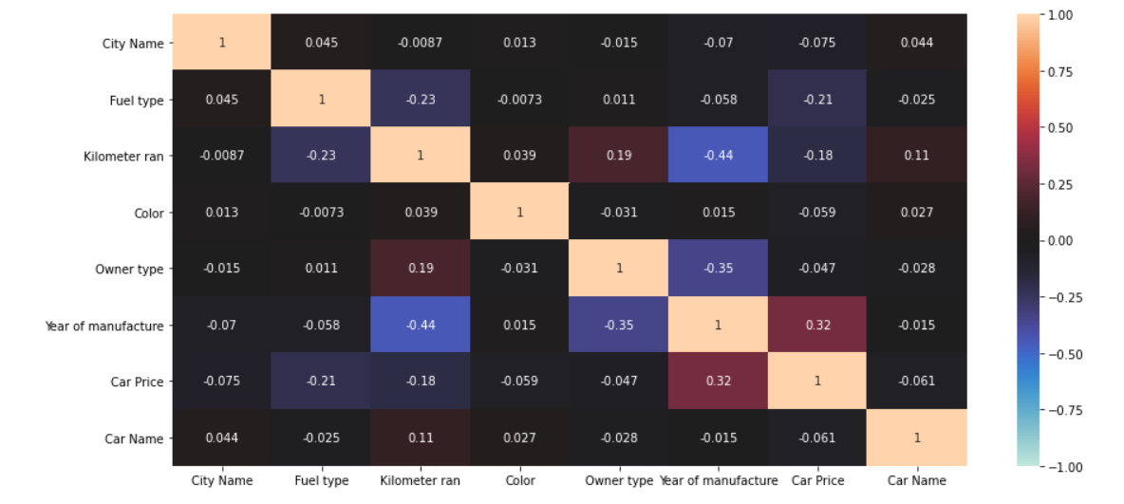
Results of Exploratory Data Analysis
The following are the interpretation we got from data analysis, For analyzing the data we took the help of data visualization libraries like seaborn, Matplotlib, plotly,Tableau software, First we drew the correlation and heatmaps from which we came to know which are the significant variables which decides the second hand car price.

Slide 7
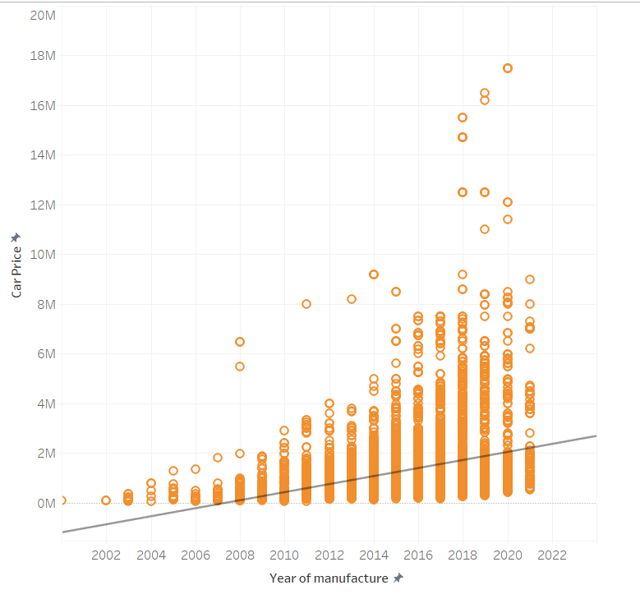
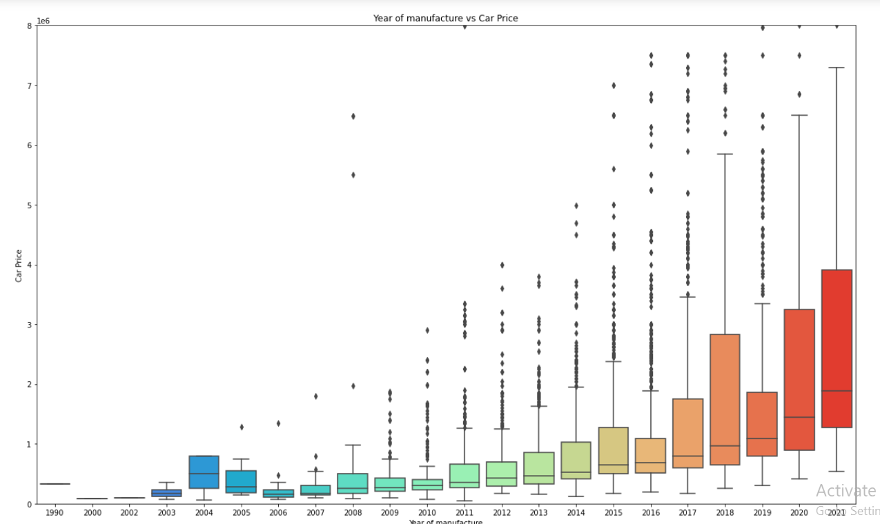
1.Car Price vs Year of manufacture
From the above graphs we can infer that as the year of the car increases the price will decreases.

Slide 8
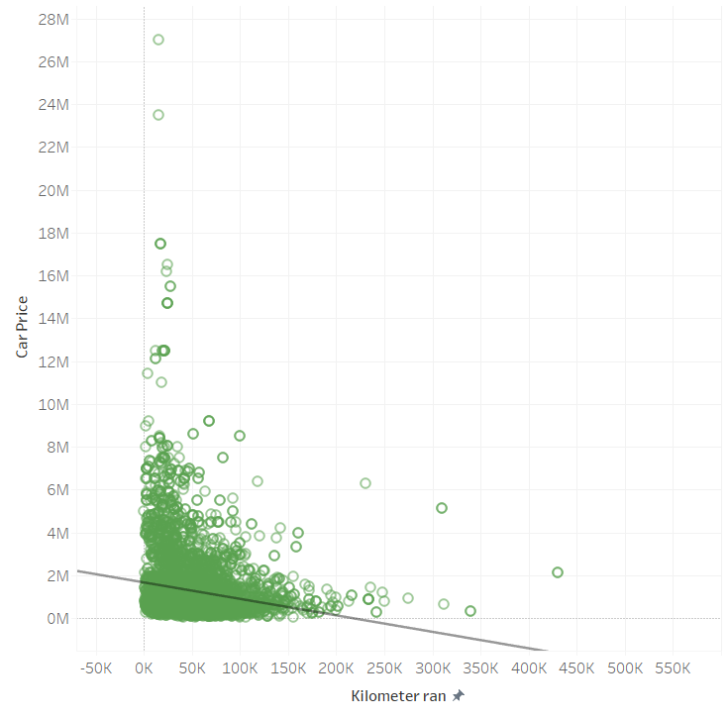
2.Car Price vs Kilometer Ran
From the above graph we can infer that as kilometer ran increases the price of the car also going to decreases.

Slide 9
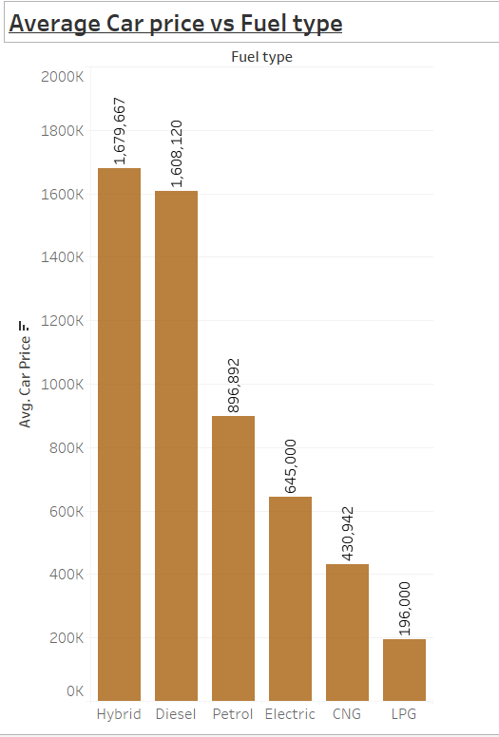
3.Car Price vs Fuel type

Slide 10
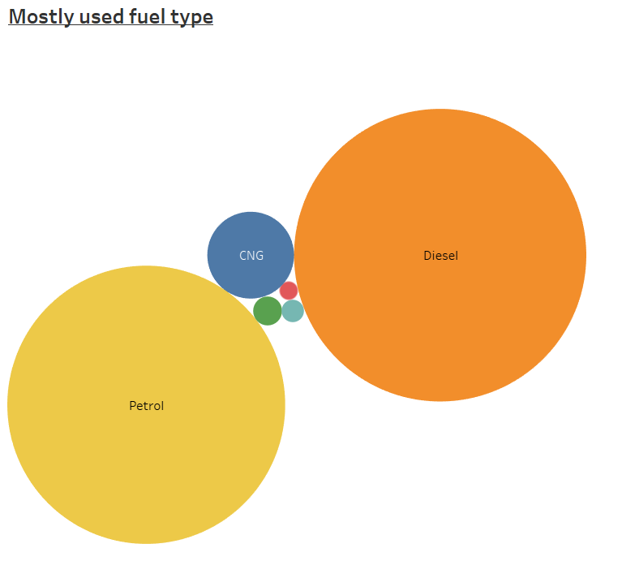

From the above graphs we can say that mostly used fuel type is diesel followed by petrol and CNG
The average price of hybrid fuel type cars are more followed by diesel and petrol.

Slide 11
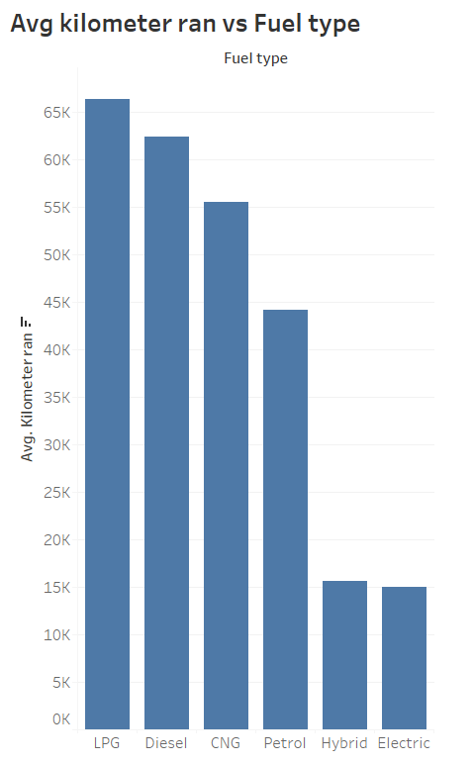
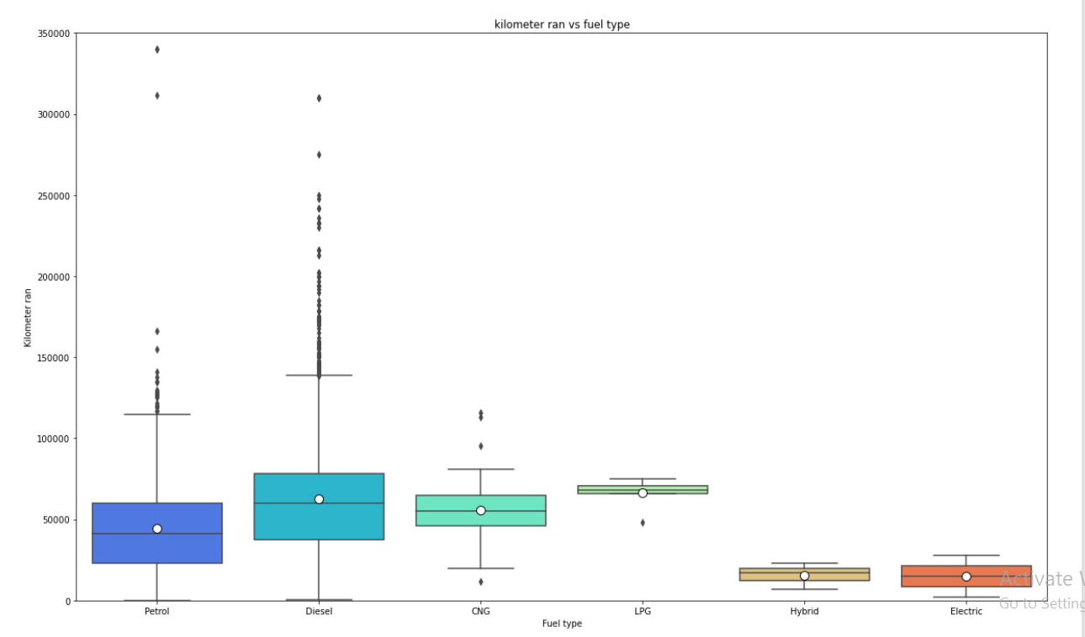
4.Kilometer ran vs fuel type
Let me interpret this result like this, suppose let’s say one of our client bought all fuel type of vehicle on same day and each day he/she ran each vehicle same distance on nth day if anyone ask just tell me if you want to sell which one you will sell first and last, then this graphs tells that client will sell electric vehicle first followed by hybrid, petrol, CNG, Diesel and LPG.

Slide 12
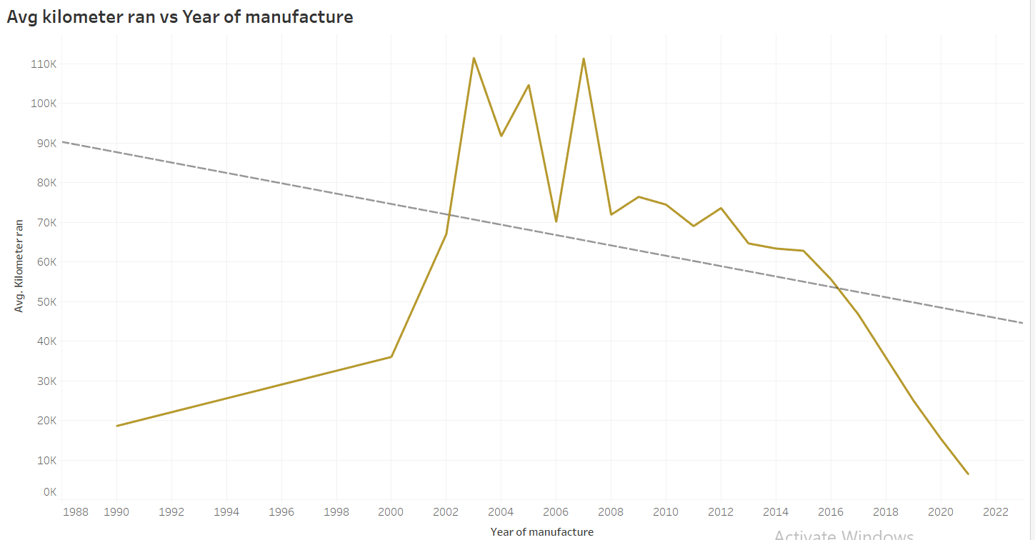
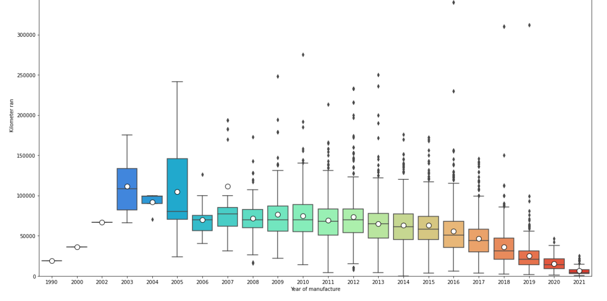
5.Year of manufacture vs Kilometer ran
From the above graph we can infer that vehicle from 2002 to 2015 ran maximum kilometers and vehicle which are manufactured after 2016 ran significantly less.

Slide 13
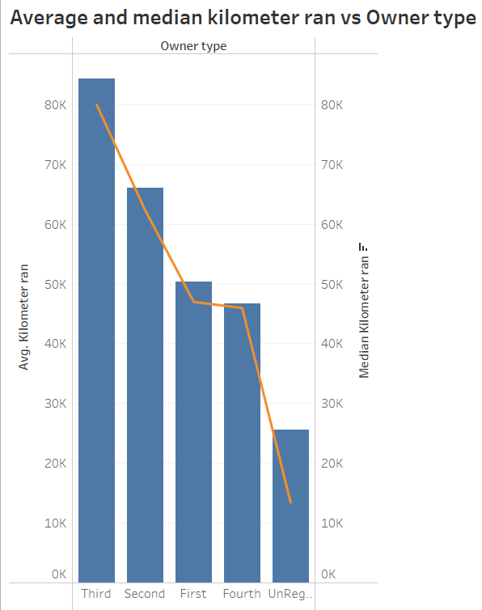

6.Kilometer ran vs Owner type
1.It displays a general fact that as owner type increases the kilometer driven would be increases but if the owner type is 4, that is fourth owner then the kilometer ran is less than compared to 1st owner type.

Slide 14
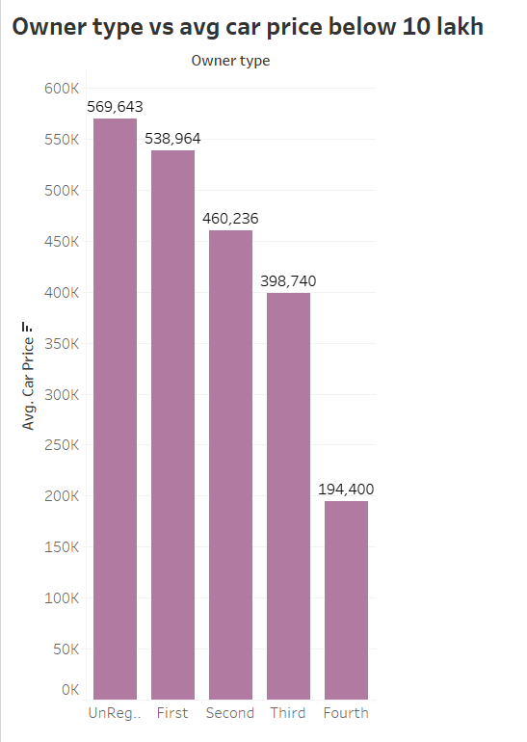
7.Average car price of cars less than 10 lakh vs owner type
The above graphs indicates that as far as possible buy unregistered, first and second owner car, because if you buy after that the price of the car will decrease quite significantly.

Slide 15
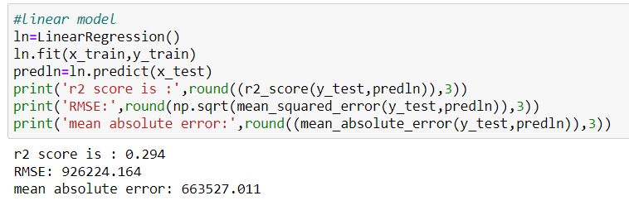
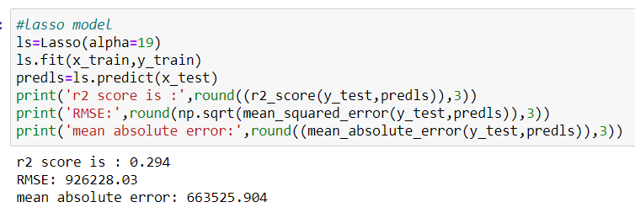
Model Building
We have used several linear regression models to evaluate and finalize the best models, The major models we have used as follows.
1.Linear Regression
2.Lasso Regression model

Slide 16
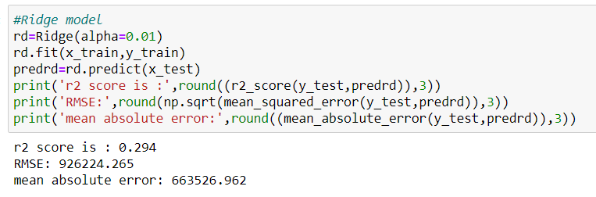
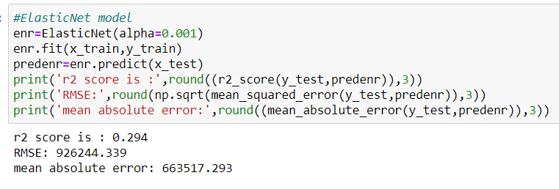
3.Ridge Regression
4.Elasticnet Regression

Slide 17
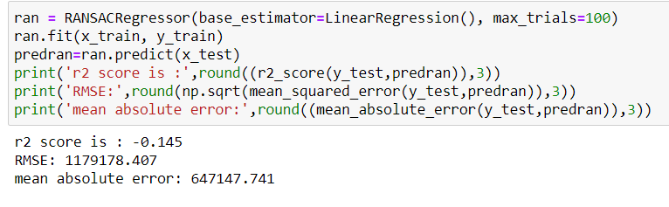
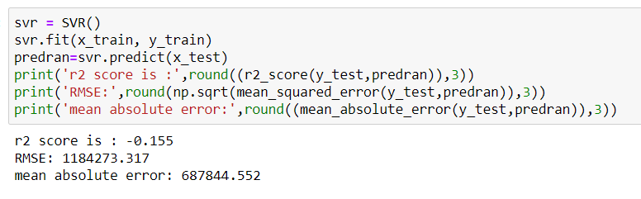
5.Ransac Regressor
6.Support Vector Regressor

Slide 18
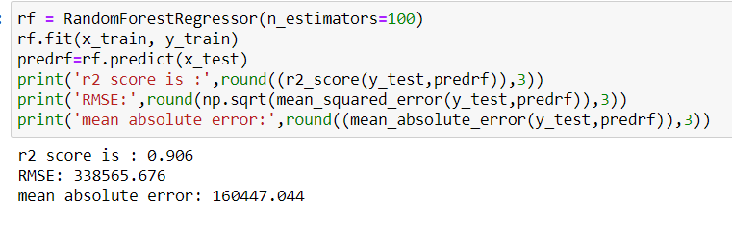
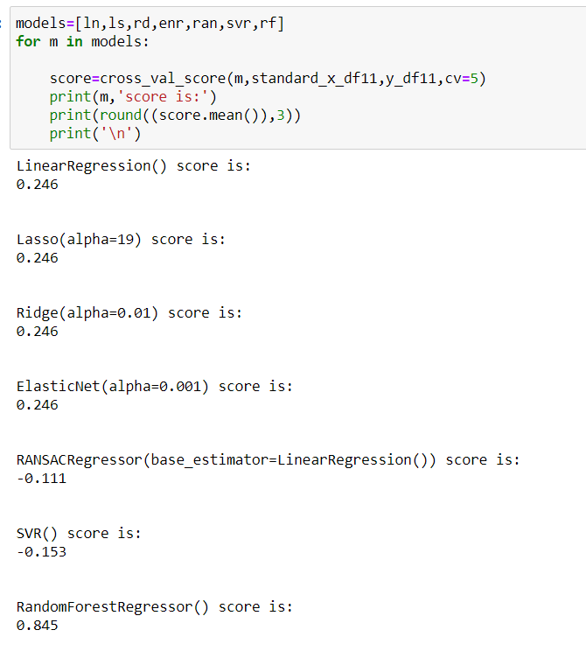
7.Random Forest Regressor
Cross Validation Score
The difference between accuracy and cross validation is less for random forest regressor, so it is the best model

Slide 19
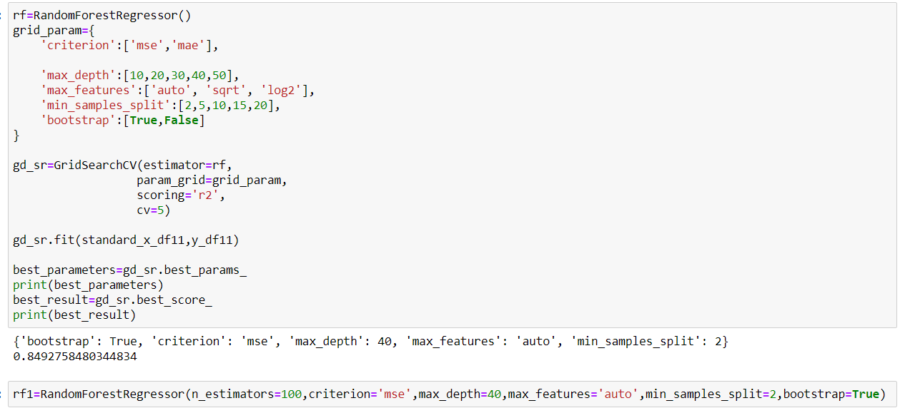
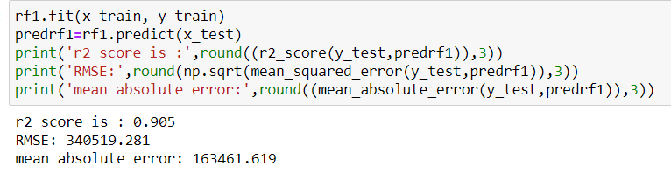
Hyper Parameter Tuning
Final Accuracy

Slide 20
Key findings and the conclusions of the study
Based on the above key findings we would like to give some prescription for our client
As far as possible try to buy car before 2016 so that we can sell it comparatively higher price.
Try to buy vehicle which ran less than 1 lakh kilometer
While choosing the fuel type give the first preference to Diesel, followed by Petrol, CNG, Hybrid
Try to avoid vehicle from 2002 to 2015, because it will get sold for less price, If its vintage then you can go for it.
Try to buy vehicle after 2016 eventually you will get higher price while selling.
Try to buy unregistered , first owner or second owner don’t go above that if its not so good in other areas.

Slide 21
Thank you

